Slide 1
INF3201: Information Systems Audit and Control
Week 3 - 7: Governance and Management of IT

Slide 2
IT governance structures
Properly implemented, governance is a process whereby senior management exerts strategic control over business functions through policies, objectives, delegation of authority, and measurement.
Governance is management’s control over all other IT processes, to ensure that IT processes continue to effectively meet the organization’s business needs.

Slide 3
IT governance is the framework that provides a formal structure for organizations to ensure IT investments support business objectives.
It's managing how organizations are run to promote transparency and accountability in business operations.
Governance became important following some high-profile corporate fraud cases in the 1990s and early 2000s.
These events prompted several countries to establish and maintain rules and regulations for corporate governance, such as the Sarbanes-Oxley Act and the Graham-Leach-Bailey Act.

Slide 4
The five domains of IT governance
IT governance is typically divided into five domains:
Value delivery, oriented to whether or not IT delivering value to the rest of the business.
Strategic alignment, which questions if the goals of IT and the organization are in alignment.
Performance Management, focused to how IT performance is being managed.
Resource Management, oriented to whether IT resources are being managed effectively and appropriately.
Risk Management, which looks if the risks are being identified, reported, and acted on.

Slide 5
Why is IT governance important?
Effective IT governance has the following benefits:
It ensures that business legal, regulatory, and compliance requirements are met.
It reduces risk.
It supports business goals and ensures that IT objectives are in alignment with the rest of the business.
It supports growth and innovation by giving the organization a solid base of operations.
It gives businesses a more competitive edge, especially if an ISO standard or other independently verified best practice initiative is in place.
It ensures that the appropriate policies, processes, and procedures are applied consistently across the organization.

Slide 6
IT governance frameworks
There are six most commonly used IT governance frameworks, each with its own principles and requirements. Let's take a closer look at them.
1. ISO 38500
ISO 38500 is the international standard for the corporate governance of information technology. It guides those advising, informing, or assisting directors on the organization's effective and acceptable use of information technology.

Slide 7
This governance framework defines six principles:
Establish responsibilities.
Plan to best support the organization.
Make acquisitions for valid reasons.
Ensure necessary levels of performance.
Ensure conformance with rules.
Ensure respect for human factors.
ISO/IEC 38500 is applicable to the governance of management decisions and processes relating to an organization's information and communication services.

Slide 8
2. ISO/IEC 27000
ISO/IEC 27000 is the standard for Information Security Management. ISO/IEC 27000:2018 provides an overview of the practice, as well as definitions commonly used in the ISMS standards.
This standard ensures that organizations have the right policies to ensure that appropriate privacy, confidentiality, and security exist around IT and cybersecurity services.

Slide 9
3. COBIT
COBIT is a detailed framework of globally accepted practices, models, and analytics tools designed for governance and management of enterprise IT. It aims to help organizations meet regulatory and risk management requirements and alleging IT strategy to the goals of the wider business.
COBIT has five fundamental principles:
Meeting stakeholder needs.
Covering the enterprise end to end.
Applying a single integrated framework.
Enabling a holistic approach.
Separating governance from management.

Slide 10
4. ITIL
ITIL is the best practice framework that enables IT departments to support the business effectively, efficiently, and safely. It has seven guiding principles:
Focus on value.
Collaborate and promote visibility.
Optimize and automate.
Start where you are.
Progress iteratively with feedback.
Keep it simple and practical.
Think and work holistically.

Slide 11
ITIL is one of the most commonly used governance frameworks across the globe.
Its main benefit is that it provides practical guidance on managing and improving IT services and the roles and responsibilities needed to support and run them.

Slide 12
5. CMMI
The Capability Maturity Model Integration (CMMI) model helps organizations effectuate process improvement and develop behaviors that decrease risks in service, product, and software development.
While CMMI was initially tailored for software development activities, the latest versions can be applied to hardware-software, and end-to-end service development. The model enables organizations to measure, build, and improve capabilities to improve overall performance.

Slide 13
The CMMI model has five levels:
Initial
Managed
Defined
Quantitatively Managed
Optimizing

Slide 14
6. Factor Analysis of Information Risk
Abbreviated as FAIR, the Factor Analysis of Information Risk is a governance model that helps organizations quantify risk.
The focus is on cyber security and operational risk to support more well-informed decision-making. It aims to provide organizations with the standards and best practices to measure, manage and report on information risk from the business perspective.

Slide 15
IT governance structure: roles and responsibilities
It's essential to remember that IT governance needs to be underpinned with roles and responsibilities to be effective.
The ITIL 4 Direct, Plan, and Improve publication recommends the following structure to aid effective IT governance:

Slide 16
Governance structure | Role in organizational governance
Board of Directors | Responsible for their organization's governance. Their key responsibilities include: Setting strategic objectives. Providing the leadership to implement the strategy. Supervising management. Reporting to shareholders.
Shareholders | Responsible for appointing directors and auditors to ensure effective governance
Audit Committee | Responsible for supporting the board of directors by providing an independent assessment of management performance and conformance

Slide 17
IT governance best practices
One of the most frequently asked questions around governance is, "How can I tell that my organization is doing it well?" The answer takes the form of more questions - namely:
Does governance have the appropriate levels of support in your organization? Is it prioritized at all levels?
Does everyone in the business know what their responsibilities are regarding organizational governance?
Does the governance body do its job effectively? Who checks?
Does the IT function make decisions independently of the rest of the business, or is there collaboration or at least oversight between the two?

Slide 18
What controls are in place to monitor IT spending to ensure transparency and fairness?
That's a lot of questions, right? Luckily, we can lean on our old friends COBIT and ISO/IEC 38500I for help. The COBIT framework has the following principles on governance, advising that IT governance should:
Satisfy stakeholder needs and generate value from the use of information and technology.
Be built from several components that can be of different types and that work together holistically.
Be dynamic, always considering the effect of changes to any of its design factors.
Clearly distinguish between management and governance activities and structures.

Slide 19
In addition to the COBIT guidance, the ISO/IEC 38500 standard defines six principles that are necessary for the effective governance of IT:
Responsibility - All colleagues understand their responsibilities and are empowered to meet them.
Strategy - Ensuring that business and IT strategies are in alignment.
Acquisition - All IT spending is transparent, with the appropriate balance of benefits, costs, and risks taken into account.

Slide 20
Performance - IT meets the needs of the business and meets the agreed service levels.
Conformance - The use of IT systems complies with all legal and regulatory requirements, and the appropriate supporting policies are well-managed and enforced.
Human behavior - IT policies, practices, and decisions demonstrate respect for human behaviors.

Slide 21
IT governance software
Tech has a significant role to play in effective IT governance. Here's how InvGate Service Desk and Insight can help:
Incident and Request Management - All IT contacts tracked across the business in one central location.
Asset Management - helping you manage, control, and protect your estate
Reporting dashboards to help with effective decision-making.
The ability to share dashboards with customers for greater transparency.

Slide 22
IT organizational structure and HR
Organizations require structure to distribute responsibility to groups of people with specific skills and knowledge. The structure of an organization is called an organization chart (org chart).
Organizing and maintaining an organization structure requires that many factors be taken into account. In most organizations, the org chart is a living structure that changes frequently, based upon several conditions including

Slide 23
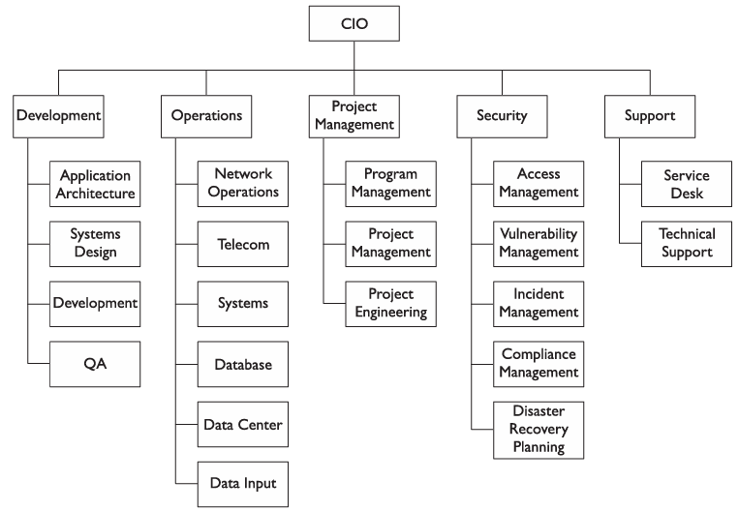

Slide 24
Short- and long-term objectives
Organizations sometimes move departments from one executive to another so that departments that were once far from each other (in terms of the org chart structure) will be near each other. This provides new opportunities for developing synergies and partnerships that did not exist before the reorganization (reorg).
These organizational changes are usually performed to help an organization meet new objectives that require new partnerships and teamwork that were less important before.

Slide 25
Market conditions
Changes in market positions can cause an organization to realign its internal structure in order to strengthen itself. For example, if a competitor lowers its prices based on a new sourcing strategy, an organization may need to respond by changing its organizational structure in order to put experienced executives in charge of specific activities.
Regulation
New regulations may induce an organization to change its organizational structure. For instance, an organization that becomes highly regulated may elect to move its security and compliance group away from IT and place it under the legal department, since compliance has much more to do with legal compliance than industry standards.

Slide 26
Attrition and available talent
When someone leaves the organization (or moves to another position within the organization), particularly in positions of leadership, a space opens in the org chart that often cannot be filled right away. Instead, senior management will temporarily change the structure of the organization by moving the leaderless department under the control of someone else. Often, the decisions of how to change the organization will depend upon the talent and experience of existing leaders, in addition to each leader’s workload and other factors.

Slide 27
For example, if the director of IT program management leaves the organization, the existing department could temporarily be placed under the IT operations department, in this case because the director of IT operations used to run IT program management. Senior management can see how that arrangement works out and later decide whether to replace the director of IT program management position or to do something else.

Slide 28
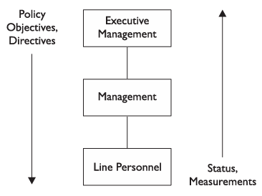
This structure serves as a top-down and bottom-up conduit of communication. Figure below depicts the communication and control that an organization provides.

Slide 29
Roles and Responsibilities
The topic of roles and responsibilities is multidimensional: it encompasses positions and relationships on the organization chart, it defines specific job titles and duties, and it denotes generic expectations and responsibilities regarding the use and protection of assets.
Individual Roles and Responsibilities
Several roles and responsibilities fall upon all individuals throughout the organization.

Slide 30
Executive management The most senior managers and executives in an organization are responsible for developing the organization’s mission, objectives, and goals, as well as policy. Executives are responsible for enacting security policy, which defines (among other things) the protection of assets.
Owner An owner is an individual (usually but not necessarily a manager) who is the designated owner-steward of an asset. Depending upon the organization’s security policy, an owner may be responsible for the maintenance and integrity of the asset, as well as for deciding who is permitted to access the asset. If the asset is information, the owner may be responsible for determining who may access and make changes to the information

Slide 31
Manager A manager is, in the general sense, responsible for obtaining policies and procedures and making them available to their staff members. They should also, to some extent, be responsible for their staff members’ behavior.
User Users are individuals (at any level of the organization) who use assets in the performance of their job duties. Each user is responsible for how he or she uses the asset, and does not permit others to access the asset in his or her name. Users are responsible for performing their duties lawfully and for conforming to organization policies.

Slide 32
Job Titles and Job Descriptions
A job title is a label that is assigned to a job description. It denotes a position in the organization that has a given set of responsibilities, and which requires a certain level and focus of education and prior experience.
An organization that has a program of career advancement may have a set of career paths or career ladders that are models showing how employees may advance. For each job title, a career path will show the possible avenues of advancement to other job titles, and the experience required to reach those other job titles.

Slide 33
Job titles in IT have matured and are quite consistent across organizations. This consistency helps organizations in several ways:
Recruiting When the organization needs to find someone to fill an open position, the use of standard job titles will help prospective candidates more easily find positions that match their criteria.
Compensation baselining Because of the chronic shortage of talented IT workers, organizations are forced to be more competitive when trying to attract new workers. To remain competitive, many organizations periodically undertake a regional compensation analysis to better understand the levels of compensation paid to IT workers in other organizations. The use of standard job titles makes the task of comparing compensation far easier.

Slide 34
Career advancement When an organization uses job titles that are consistent in the industry, IT workers have a better understanding of the functions of positions within their own organizations and can more easily plan how they can advance.

Slide 35
Virtually all organizations also include titles that denote the level of experience, leadership, or span of control in an organization. These titles may include executive vice president, senior vice president, vice president, senior director, director, general manager, senior manager, manager, and supervisor. Larger organizations will use more of these, and possibly additional titles such as district manager, group manager, or area manager.

Slide 36
Executive Management
Executive managers are the chief leaders and policy makers in an organization. They set objectives and work directly with the organization’s most senior management to help make decisions affecting the future strategy of the organization.
CIO (chief information officer) This is the title of the topmost leader in a larger IT organization.
CSO (chief security officer) This position is responsible for all aspects of security, including information security, physical security, and possibly executive protection (protecting the safety of senior executives).

Slide 37
CISO (chief information security officer) This position is responsible for all aspects of data-related security. This usually includes incident management, disaster recovery, vulnerability management, and compliance.
CPO (chief privacy officer) This position is responsible for the protection and use of personal information. This position is found in organizations that collect and store sensitive information for large numbers of persons.

Slide 38
Software Development Positions in software development are involved in the design, development, and testing of software applications.
Systems architect This position is usually responsible for the overall information systems architecture in the organization. This may or may not include overall data architecture as well as interfaces to external organizations.
Systems analyst A systems analyst is involved with the design of applications, including changes in an application’s original design. This position may develop technical requirements, program design, and software test plans. In cases where organizations license applications developed by other companies, systems analysts design interfaces to other applications.

Slide 39
Software developer, programmer This position develops application software. Depending upon the level of experience, persons in this position may also design programs or applications. In organizations that utilize purchased application software, developers often create custom interfaces, application customizations, and custom reports.
Software tester This position tests changes in programs made by software developers.

Slide 40
Data Management Positions in data management are responsible for developing and implementing database designs and for maintaining databases.
Database architect This position develops logical and physical designs of data models for applications. With sufficient experience, this person may also design an organization’s overall data architecture.

Slide 41
Database administrator (DBA) This position builds and maintains databases designed by the database architect and those databases that are included as a part of purchased applications. The DBA monitors databases, tunes them for performance and efficiency, and troubleshoots problems.
Database analyst This position performs tasks that are junior to the database administrator, carrying out routine data maintenance and monitoring tasks.

Slide 42
Network Management Positions in network management are responsible for designing, building, monitoring, and maintaining voice and data communications net works, including connections to outside business partners and the Internet.
Network architect This position designs data and (increasingly) voice networks and designs changes and upgrades to the network as needed to meet new organization objectives.

Slide 43
Network engineer This position builds and maintains network devices such as routers, switches, firewalls, and gateways.
Network administrator This position performs routine tasks in the network such as making minor configuration changes and monitoring event logs.
Telecom engineer Positions in this role work with telecommunications technologies such as data circuits, phone systems, and voicemail systems.

Slide 44
Systems Management Positions in systems management are responsible for architecture, design, building, and maintenance of servers and operating systems. This may include desktop operating systems as well.
Systems architect This position is responsible for the overall architecture of systems (usually servers), both in terms of the internal architecture of a system, as well as the relationship between systems. This position is usually also responsible for the design of services such as authentication, e-mail, and time synchronization.

Slide 45
Systems engineer This position is responsible for designing, building, and maintaining servers and server operating systems.
Storage engineer This position is responsible for designing, building, and maintaining storage subsystems.
Systems administrator This position is responsible for performing maintenance and configuration operations on systems.

Slide 46
Operations Positions in operations are responsible for day-to-day operational tasks that may include networks, servers, databases, and applications.
Operations manager This position is responsible for overall operations that are carried out by others. Responsibilities will include establishing operations shift schedules.
Operations analyst This position may be responsible for the development of operational procedures; examining the health of networks, systems, and databases; setting and monitoring the operations schedule; and maintaining operations records.

Slide 47
Controls analyst This position is responsible for monitoring batch jobs, data entry work, and other tasks to make sure that they are operating correctly.
Systems operator This position is responsible for monitoring systems and networks, performing backup tasks, running batch jobs, printing reports, and other operational tasks.
Data entry This position is responsible for keying batches of data from hardcopy sources.
Media librarian This position is responsible for maintaining and tracking the use and whereabouts of backup tapes and other media.

Slide 48
Security Operations Positions in security operations are responsible for designing, building, and monitoring security systems and security controls, to ensure the confiden tiality, integrity, and availability of information systems.
Security architect This position is responsible for the design of security controls and systems such as authentication, audit logging, intrusion detection systems, intrusion prevention systems, and firewalls.
Security engineer This position is responsible for designing, building, and maintaining security services and systems that are designed by the security architect.

Slide 49
Security analyst This position is responsible for examining logs from firewalls, intrusion detection systems, and audit logs from systems and applications. This position may also be responsible for issuing security advisories to others in IT.
User account management This position is responsible for accepting approved requests for user access management changes and performing the necessary changes at the network, system, database, or application level. Often this position is carried out by personnel in network and systems management functions; only in larger organizations is user account management performed in security or even in a separate user access department.
Security auditor This position is responsible for performing internal audits of IT controls to ensure that they are being operated properly.

Slide 50
Service Desk Positions at the service desk are responsible for providing frontline support services to IT and IT’s customers.
Helpdesk analyst This position is responsible for providing frontline user support services to personnel in the organization.
Technical support analyst This position is responsible for providing technical support services to other IT personnel, and perhaps also to IT customers.

Slide 51
Segregation of Duties Information systems often process large volumes of information that is sometimes high ly valuable or sensitive. Measures need to be taken in IT organizations to ensure that individuals do not possess sufficient privileges to carry out potentially harmful actions on their own.
Checks and balances are needed, so that high-value and high-sensitivity activities involve the coordination of two or more authorized individuals.
The concept of segregation of duties (SOD), also known as separation of duties, ensures that single indi viduals do not possess excess privileges that could result in unauthorized activities such as fraud or the manipulation or exposure of sensitive data.

Slide 52
The concept of segregation of duties has been long-established in organization accounting departments where, for instance, separate individuals or groups are responsible for the creation of vendors, the request for payments, and the printing of checks. Since accounting personnel frequently handle checks and currency, the principles and practices of segregation of duties controls in accounting departments are the norm.
IT departments are lagging behind somewhat, since the functions in IT are less-often involved in direct monetary activities (except in certain industries such as banking). But thanks to financial scandals in the 1980s and 1990s that involved the illicit manipulation of financial records, the need for full and formal IT-level segregation of duties is now well recognized.

Slide 53
Segregation of Duties Controls
Preventive and detective controls should be put into place to manage segregation of duties matters. In most organizations, both the preventive and detective controls will be manual, particularly when it comes to unwanted combinations of access between different applications. However, in some transaction-related situations, controls can be automated, although they may still require intervention by others.

Slide 54
Some examples of segregation of duties controls include
Transaction authorization Information systems can be programmed or configured to require two (or more) persons to approve certain transactions. Many of us see this in retail establishments where a manager is required to approve a large transaction or a refund. In IT applications, transactions meeting certain criteria (for example, exceeding normally accepted limits or conditions) may require a manager’s approval to be able to proceed.
Split custody of high-value assets Assets of high importance or value can be protected using various means of split custody. For example, a password to an encryption key that protects a highly valued asset can be split in two halves, one half assigned to two persons, and the other half assigned to two persons, so that no single individual knows the entire password. Banks do this for

Slide 55
Workflow Applications that are workflow-enabled can use a second (or third) level of approval before certain high-value or high-sensitivity activities can take place. For example, a workflow application that is used to provision user accounts can include extra management approval steps in requests for administrative privileges.
Periodic reviews IT or internal audit personnel can periodically review user access rights to identify whether any segregation of duties issues exist. The access privileges for each worker can be compared against a segregation of duties control matrix.

Slide 56
When SOD issues are encountered during a segregation of duties review, management will need to decide how to mitigate the matter. The choices for mitigating a SOD issue include
Reduce access privileges Management can reduce individual user privileges so that the conflict no longer exists.
Introduce a new mitigating control If management has determined that the person(s) need to retain privileges that are viewed as a conflict, then new preventive or detective controls need to be introduced that will prevent or detect unwanted activities. Examples of mitigating controls include increased logging to record the actions of personnel, improved exception reporting to identify possible issues, reconciliations of data sets, and external reviews of high-risk controls.

Slide 57
IT strategy and direction
Definition of IT Strategy
IT strategy is a long-term plan outlining how an organization will utilize technology to achieve its goals and objectives. It involves aligning technology with business strategy to ensure technology investments align with business priorities.
An effective IT strategy should provide a roadmap for technology investments, outlining how they will create business value and support the organization's growth and development. IT strategy typically takes the form of a written document. This document serves as a blueprint for the organization's IT initiatives and helps to ensure that everyone is aligned on the overall IT direction.

Slide 58
But IT strategy is much more than project planning and budgeting — rather, it is an opportunity to frame how your IT team contributes to the overall business. This process involves establishing your vision and mission, forming strategic goals, defining the work you will do to reach those goals, and measuring the impact on the business over time.
What is the purpose of IT strategy?
IT strategy explains the "why" behind what you do and paints the big picture for the team. Each component helps to color in that picture — allowing you to set priorities and connect all of your work back to its larger purpose.

Slide 59
You can also think of it as your north star. A clear IT strategy will guide you towards achieving your goals amid competing priorities. Your IT team should be able to refer to the IT strategy at any time to see why the work you are doing matters.
Who is responsible for IT strategy?
IT strategy is typically led by the chief information officer (CIO), chief technology officer (CTO), or other senior IT roles that have the best visibility into overall business needs and goals.
But IT leaders are not the only ones responsible for capturing and implementing the strategy. Everyone on the IT team has a stake — after all, the entire organization uses the systems, software, tools, and data storage that your team provides.

Slide 60
What should an IT strategy include?
Your IT strategy should encompass your vision, mission, goals, and initiatives. Each element helps to define the "why" behind the work you do as an IT team.
Vision
Vision rallies everyone around a shared blueprint for the future. Many organizations have a vision statement at the company level.
SaaS companies typically have a product vision as well. Product vision explains what you want your product to be, why it is important, and how it connects to the overarching company vision.

Slide 61
.
Mission
Your vision and mission go hand-in-hand. When building your IT strategy, you should write a mission statement to describe the approach you will take to reach your vision. IT mission statements should generally answer these questions:
What do we build and support?
Who do we build it for?
How will it benefit our company and/or customers?
Here is an example of an IT team mission statement:
“We will help internal customers be happier and more productive by delivering reliable and scalable technology, processes, and support”

Slide 62
Goals
Goals are time-bound, measurable objectives that describe how you plan to make progress towards your vision and mission. Your IT goals help you answer the following questions:
What specific problems are we trying to solve?
Why is solving them important?
What is our time frame?
How will we measure success?
How will our work support the business?

Slide 63
So if your mission states that you want to improve customer happiness and productivity, your goals should align with improvements to the customer experience. For example:
Improve IT help desk response time by 30 percent within the next six months.
Improve testing coverage for a new product release this quarter by automating 80 percent of tests.
Of course, your goals will be tailored to your IT team structure and your organization's needs.

Slide 64
What is strategic direction?
Strategic direction refers to the foundational ideas or actions that allow for greater consistency in strategy over time. It ultimately helps a company achieve its vision and helps it fulfill the goals of its organizational strategy. It also helps unite a company's strategies and provides for greater stability into the future. When an organization has a strategic direction, it helps determine the company's objectives and how it plans to accomplish them, it helps determine the required resources and it helps identify how an organization needs to operate in order to find success.

Slide 65
Types of strategic direction
Companies use various types of strategic directions to help it achieve a wide variety of goals.
Here are seven types of strategic direction:
Mission
A mission establishes your company's purpose and explains why it exists. Companies use their mission as a guide for meeting its goals. For example, if your company has a mission to provide the highest quality jeans compared to other companies on the market, this allows for a greater long-term strategic direction that focuses on quality rather than focusing on goals like saving costs.

Slide 66
Culture
Company culture refers to employee attitudes and behaviors within an organization. While it's hard to change company culture, culture itself helps to shape a company's strategic direction. For example, if you have a company with a service culture regarding the company's customers, you can easily improve your customer service where other companies don’t.
Vision
A company's vision highlights what the organization hopes to be and achieve in the future. It ultimately provides strategic direction alongside a company's mission statement. When a company has a particular vision, it can use it to modify its current business plan and spending in a way that better aligns with its vision.

Slide 67
Values
Values refer to a company's fundamental beliefs. In other words, they refer to a company's principles that are right or wrong. Values help guide your organization and help employees work better toward common goals. Some examples of common company values include integrity, fairness and accountability.
Ideology
An ideology is a belief that defines a company's purpose. It describes how you want to conduct yourself with your employees, with your clients and with your industry at large. Ideology provides strategic direction through consistent and stable policies over time. Since it's part of a company's vision, you can use ideology to help your company aspire to what you want it to become.

Slide 68
Principles
Principles are guidelines or rules that give future strategy and decision making greater direction. For example, if you work for a technology company, you may have the principle that all data needs encryption. This means it can't have encryption lapses, which ultimately provides strategic direction for the company's future projects and initiatives.
Grand strategy
This refers to a long-term strategy that includes every approach and tool you can find. Even current strategies that seem irrational may make better sense when you consider the grand strategy.For example, if an electric car manufacturer allows the free use of its patents by competing manufacturers, it may seem irrational from a business standpoint. However, opening them up to competitors may increase the rate of adoption for these vehicles and charging stations.

Slide 69
How to set a strategic direction
Strategic direction focuses on the plans and actions you need to implement in order to progress toward a vision for the organization's future. To gain the most value from having a strategic direction, you need to analyze every area and process of an organization. Use these steps to set a strategic direction:
1. Consider your vision for the company. The importance of a strategic direction involves your ability to consider its overall purpose. Think of your vision for the company. Essentially, think of your reason for wanting this business to exist.

Slide 70
2. Reflect on your company's mission. Consider your company's mission or how you plan to make your vision come true. Typically, a mission statement may include information about a company's products and services.
3. Develop a plan. Identify your future direction and include your stakeholders in the process. You can involve them through various ways such as meetings or phone surveys.

Slide 71
4. Set periodic goals. Create short-, medium- and long-term goals. Start with your long-term goals that can ultimately help you achieve your mission and vision. Then, create medium-term goals that span a few years and eventually, set short-term goals that help separate your long-term planning into more achievable steps.
5. Set quantifiable goals. As you create goals, account for measurability. When you have specific and measurable goals, it's easier to see what you need to do to achieve them. Quantifiable goals also you track your progress and success throughout every stage of the process.

Slide 72
IT policies, standards and procedures
The IT world has changed a lot over the past year. While security threats have gone up significantly, we also witnessed major disruptions in various other aspects of IT.
For instance, the sudden transition to remote and hybrid working environments has created additional issues with regards to the effective usage of IT products, value creation, service delivery, efficiency and more. To bring order to this chaos, you need an action guide of sorts, outlining clear rules of managing IT that align with your business objectives.
Clear guidelines need to be established in the form of IT policies and procedures to help you with various aspects including information security, IT governance, responsible use of data, security awareness, business continuity and more.

Slide 73
What Are IT Policies and Procedures?
IT policies and procedures establish guidelines for the use of information technology within an organization. In other words, it outlines what everyone is expected to do while using company assets.
With the help of strong policies and procedures, you can incorporate actions that are consistent, effective and efficient. In addition to helping you combat security threats by creating proper awareness, documented policies and procedures can also define how you incorporate and manage technology in your corporate environment.

Slide 74
What Is the Difference Between Policies and Procedures?
To come up with an effective framework for IT guidelines, you need to understand the difference between policies and procedures first.
Policies: Policies are general guidelines about an organization’s IT plan. They provide the parameters for decision-making. However, they do not focus on the details of implementation. Policies mainly focus on communicating an organization’s values, culture and philosophy with regard to IT. A good policy explains the rules and presents them in a logical framework.

Slide 75
Procedures: Procedures outline the step-by-step implementation of various tasks. From beginning to end, procedures will show you what actions to take under specific circumstances. With procedures, you can achieve the desired outcome. For instance, an employee onboarding checklist provides you with a list of specific tasks for onboarding a new hire. In other words, it gives you a step-by-step onboarding procedure.

Slide 76
Procedures are written to support the implementation of the policies. Because policies change between organizations, defining which procedures must be written is impossible. For example, if your organization does not perform software development, procedures for testing and quality assurance are unnecessary. However, some types of procedures might be common amongst networked systems, including
Auditing—These procedures can include what to audit, how to maintain audit logs, and the goals of what is being audited.
Administrative—These procedures can be used to have a separation of duties among the people charged with operating and monitoring the systems. These procedures are where you can show that database administrators should not be watching the firewall logs.

Slide 77
Access control—These procedures are an extension of administrative procedures that tell administrators how to configure authentication and other access control features of the various components.
Configuration—These procedures cover the firewalls, routers, switches, and operating systems.
Incident response—These procedures cover everything from detection to how to respond to the incident. These procedures should discuss how to involve management in the response as well as when to involve law enforcement.

Slide 78
Physical and environmental—These procedures cover not only the air conditioning and other environmental controls in rooms where servers and other equipment are stored, but also the shielding of Ethernet cables to prevent them from being tapped.
Implementation of these procedures is the process of showing due diligence in maintaining the principles of the policy. Showing due diligence is important to demonstrate commitment to the policies, especially when enforcement can lead to legal proceedings. Demonstrating commitment also shows management support for the policies. When management does not show this type of commitment, the users tend to look upon the policies as unimportant. When this happens, a disaster will eventually follow.

Slide 79
Why Is It Important to Have Policies and Procedures?
An organization needs both policies and procedures to thrive in a competitive environment. Your IT policies and procedures guide your organization on various aspects of implementing IT the right way. They also bring consistency to organizational processes. With consistency in IT guidelines, you can serve your customers better and boost your brand’s reputation.

Slide 80
What Are the Benefits of Policies and Procedures?
Some of the notable benefits of IT policies and procedures are as follows:
Adherence to Compliance: Every industry has its own set of data laws and regulations governing the handling and usage of customer data. Moreover, various regions also have their own specific compliance regulations relating to data privacy. With standardized IT policies and procedures, you can easily adhere to these compliance regulations and ensure best industry practices.

Slide 81
Internal Process Improvement: Strong policies and guidelines can help you improve your internal processes. When companies scale up, the policies that once applied may no longer be valid. By constantly reviewing and updating your policies and procedures, you can ensure efficiency in internal processes and provide more value to your customers. You can also use policies to ensure consistent service delivery, increase employee knowledge and outline clear expectations from employees regarding specific tasks.
Overcome Issues and Crises: Clear policies and procedures can help you avoid workplace incidents with regard to security. Even if something happens inevitably, you will have clear guidelines on the actions to be taken. When you have well-drafted policies on incident response, customer service, data backup, etc., you can mitigate damages to your reputation in case something goes wrong.

Slide 82
What Should an IT Policy Include?
Coming up with an effective IT policy can be a long and hard process. Since IT affects all aspects of a business in today’s scenario, various stakeholders from different departments must be involved when drafting a policy document.
A policy document should be written in simple language for everyone to understand. While it should outline the framework of IT guidelines, it should not be excessively restrictive. It should be flexible and leave room for improvement.

Slide 83
What Are the Key Components of an IT Policy?
There are various components involved when drafting an IT policy. Let’s discuss them in detail.
Develop a Mandate: You need to come up with a mandate that identifies the specific IT goals of your organization. This will help you determine the tone and content of your IT policy.
Use a Template: You don’t have to develop everything from the scratch. With a standard template, you can streamline your writing process and cut down on time wastage. The template can provide you with the framework of the content that should be included.

Slide 84
Do Your Research: To start your research, consider the existing processes you have in your company first. This should be followed by external research on how to make the existing policies better. You should also research any potential issues you may encounter here.
Develop a Draft: Once you have done your research, it is time to come up with an initial draft. You need to limit the use of department-specific jargon and come up with a draft that works for everyone.
Review and Validate: Once it is drafted, you need to get it reviewed by all the stakeholders involved. You can make amendments to the draft based on their feedback and validate the final copy.

Slide 85
What Policies Should an IT Department Have?
There are various policies specific to the IT department of a company. Right from managing various IT assets to ensuring data security, an IT department should have clear policies required for an organization.
Some of the key policies applicable to IT departments include:
IT Asset Management Policies
These policies describe the guidelines to be practiced with regards to the IT assets in an organization. It should have specific protocols on what types of assets are admissible for specific tasks. You also need to have a BYOD (bring your own device) policy that describes whether employees are allowed to use their own devices to connect to an organization’s network.

Slide 86
IT Software Management Policies
These policies help companies manage their software tools effectively. From specifying the list of authorized tools to software automation, you need to have comprehensive policies that outline the appropriate usage of the software. You also need to focus on patching policies to ensure all your software tools are updated at the right time.
IT Security Policies
IT security involves various aspects, including information security, password management, remote access and security training. You need strong policies for both risk prevention and damage mitigation. You also need to provide regular training to your employees to make sure security efforts are imparted in the right way.

Slide 87
IT Emergency Response Policies
How you react to a security incident can make or break your business. You need policies on incident response, business continuity and disaster recovery, data recovery and data encryption. With a strong incident response plan, you can mitigate the damages resulting from a breach and resume operations instantly.
IT Employment Policies
Specific policies should be drafted and implemented for people who work in IT. Most importantly, it should set clear expectations of what needs to be performed in their specific job roles. Good policies need to be established for regular training, responsibilities, access to critical information, performance and more. This helps you manage expectations from the everyday performance of your employees.

Slide 88
How Do You Implement New Policies and Procedures?
Once the policies are drafted and finalized, you need to come up with a plan to implement those policies and procedures. First, you need to come up with a distribution plan to take the policies to all stakeholders involved. You need an automated documentation software tool that can deliver all your policies and future updates instantly across the company. Once it is delivered, make sure that everyone has understood them and signed off on their implementation.
Certain aspects of your IT policies might require training from subject matter experts. If required, you can create training manuals and deliver them through your documentation software. Once the new policies and procedures are implemented, you need to regularly review them as your company evolves.

Slide 89
Who Is Responsible for Policies and Procedures in an Organization?
Policies are typically developed based on the vision and objectives of an organization. IT-specific policies are drafted by IT managers and overseen by the IT administrators in an organization. Determining the policies, however, is a collaborative effort that gleans inputs from various stakeholders in the organization. To make it a company-wide policy, the HR department plays a huge role and works with managers of other departments to ensure effective implementation.

Slide 90
Documenting IT Policies and Procedures With IT Glue
IT Glue is the leading, cloud-based documentation platform that can securely document your most valued information into standardized and centralized knowledge. When drafting new policies and procedures, you need to gather information from various teams and put them together. IT Glue helps you manage everything from a single pane of glass and puts everything at your fingertips.
IT Glue’s SOC 2-compliant documentation platform features an immutable audit trail, multifactor authentication and next-generation password management engine, all of which are fully integrated and linked with all your documentation.

Slide 91
IT Standards
IT Standards describe technical requirements for conformance with policies; they may describe specific configurations, timelines, or processes to meet these requirements.
Standards are necessary courses of action or regulations that provide support and direction to formal policies. Getting a company wide consensus on what standards should be in place is one of the more difficult aspects of creating standards for an information security program. This is a time-consuming process, but it is necessary for your information security program to succeed.

Slide 92
Standard is a term that’s used to describe how a user is likely to behave like a uniform company email signature, for example.
It’s possible that you’ll be able to define which hardware and software solutions are available and supported.
It is possible for a third-party norm to be voluntary or mandatory. Typically, the default position is that they are optional.

Slide 93
Setting Standards
When creating policies for an established organization, there is an existing process for maintaining the security of the assets. These policies are used as drivers for the policies. For other policies in which there are no technology drivers, standards can be used to establish the analysts' mandatory mechanisms for implementing the policy.
Regardless of how the standards are established, by setting standards, policies that are difficult to implement or that affect the entire organization are guaranteed to work in your environment. Even for small organizations, if the access policies require one-time-use passwords, the standard for using a particular token device can make interoperability a relative certainty.

Slide 94
An IT organization will have different types of standards: Technology standards
• These standards specify what software and hardware technologies are used by the IT organization. Examples include operating system, database management system, application server, storage systems, backup media, and so on.
Protocol standards
• These standards specify the protocols that are used by the organization. For instance, an IT organization may opt to use TCP/IP v6 for its internal networks, GRP routing protocols, FTPS for file transfer, SSH for device management, and so forth.

Slide 95
Supplier standards
This defines which suppliers and vendors are used for various types of supplies and services. Using established suppliers can help the IT organization through specially negotiated discounts and other arrangements.
Methodology standards
This refers to practices used in various processes including software development, system administration, network engineering, and end-user support.

Slide 96
Configuration standards
This refers to specific detailed configurations that are to be applied to servers, database management systems, end-user workstations, network devices, and so on. This enables users, developers, and technical administrative personnel to be more comfortable with IT systems, because the systems will be consistent with each other. This helps to reduce unscheduled downtime and to improve quality.
Architecture standards
This refers to technology architecture at the database, system, or network level. An organization may develop reference architectures for use in various standard settings. For instance, a large retail organization may develop specific network diagrams to be used in every retail location, down to the colors of wires to use and how equipment is situated on racks or shelves

Slide 97
QMS and IT management of controls
What is the Definition of Quality Management System (QMS)?
A Quality Management System (QMS) is a formalized system that documents processes, procedures, and responsibilities for achieving quality policies and objectives. A QMS ensures that products or services are consistently in compliance with customer and regulatory requirements. It achieves this by maintaining records of activities, which serve as evidence that quality-related tasks are being systematically performed.

Slide 98
A Quality management system encompasses the planning, quality control, quality assurance, and improvement of quality across various operations, aiming to enhance customer satisfaction and improve compliance with regulatory requirements.
An objective of a QMS is to manage a company’s activities to comply with customer and regulatory requirements while continuously improving effectiveness and efficiency through the systematic management of quality-related activities.

Slide 99
What Are the Different QMS Formats?
QMS can be implemented in various formats – electronic, paper-based, and hybrid, each catering to different organizational needs and preferences.
Below is an overview of the three primary QMS formats.
Electronic Quality Management System (eQMS)
Electronic Quality Management System (eQMS) refers to a digital solution designed to streamline and automate the quality management processes within a company.

Slide 100
The most common variations of the term “Electronic Quality Management System (eQMS)” are listed below.
eQMS
eQMS software
QMS software
Digital QMS
Quality management software
An eQMS comprises a suite of QMS tools, which are essentially software modules and predefined workflows designed to automate and streamline specific quality management processes.
QMS software typically integrates various quality management elements, such as document control, change control, training management, corrective and preventive actions (CAPA) management, audit management, supplier management, and many others.

Slide 101
Paper-Based QMS
Paper-based QMS relies on physical documents for recording and tracking quality-related information.
Paper-based QMS offers simplicity and physical documentation and may be more cost-effective and accessible for some smaller companies. However, for larger companies, paper-based QMS can be less cost-effective in document control, scalability, and efficiency.

Slide 102
Why is Quality Management System (QMS) Important?
A Quality Management System is a requirement in several regulations, standards, and guidelines across multiple industries.
A QMS supports companies in achieving and maintaining compliance with customer and regulatory requirements. It ensures a company consistently delivers uniform and high-quality products or services.
By creating and implementing a QMS, companies gain multiple benefits, such as improving efficiency, ensuring compliance, reducing waste, decreasing costs, enhancing customer satisfaction, and ultimately achieving business growth and success.

Slide 103
What are the Benefits of Quality Management Systems?
The main benefits of QMS are listed below.
Improved Regulatory Compliance: QMS ensures that companies adhere to industry regulations, standards, and guidelines, reducing the risk of non-compliance and associated legal consequences.
Improved Customer Retention and Satisfaction: QMS enhances customer satisfaction by consistently delivering uniform and high-quality products or services, fostering loyalty, and increasing the likelihood of repeat business.

Slide 104
Promoted Continuous Improvement: QMS encourages a culture of continuous improvement, empowering companies to identify areas for improvement, implement changes, and optimize processes over time.
Developed Operational Consistency: QMS establishes standardized processes, leading to consistent and reliable outcomes, reducing variability, and ensuring a uniform approach across operations.

Slide 105
Enhanced Internal Communications: QMS promotes effective communication within the company, ensuring that all stakeholders are well-informed, leading to improved collaboration and teamwork.
Streamlined Employee Training: QMS provides a structured framework for employee training, ensuring that staff members are adequately trained and qualified to perform their roles efficiently.

Slide 106
IT Controls
What are IT controls?
An IT control is a procedure or policy that provides a reasonable assurance that the information technology (IT) used by an organization operates as intended, that data is reliable and that the organization is in compliance with applicable laws and regulations. IT controls can be categorized as either general controls (ITGC) or application controls (ITAC).
IT controls provide criteria an IT organization should follow to ensure that staff members are performing roles and responsibilities according to standards, regulations and established good practices

Slide 107
Why are IT controls important?
An IT general control should demonstrate that the organization has a procedure or policy in place for technology that affects the management of fundamental organizational processes such as risk management, change management, disaster recovery and security. IT application controls, which are actions that a software application does automatically, should demonstrate that software applications used for specific business processes (such as payroll) are properly maintained, are only used with proper authorization, are monitored and are creating audit trails

Slide 108
Controls provide a framework for how specific activities and functions should perform. They are particularly important when it is necessary to demonstrate compliance with specific standards (e.g., ISO 27001 and NIST SP 800-34), regulations (e.g., GDPR) and legislation (e.g., SOX, GLBA, HIPAA and FISMA).
Senior management needs to know and have evidence that the IT department is managing the firm’s IT operations in a way that maximizes performance and minimizes risk. Audits using IT controls can demonstrate that the technology infrastructure is supporting the company's business goals.

Slide 109
Who needs to know about IT controls?
Within an IT department, the IT audit team (if one is available) needs to know about the IT controls that are in place. Corporate internal audit departments will likely have information on IT controls, especially if they perform IT audits. Third-party audit firms will need to have (and demonstrate) significant expertise in and knowledge of IT controls.
Members of IT audit teams will need to be knowledgeable of not only their own areas, but also other areas and activities. Typically, they can be either specialists in specific activities such as data storage, or they can have broader expertise in many IT functions.

Slide 110
What are IT general controls?
IT general controls (ITGCs) focus on how systems perform within the context of the confidentiality, integrity and availability of information. The table below, "Examples of general computer controls," presents a sampling of IT general controls by category followed by examples of actual control statements

Slide 111
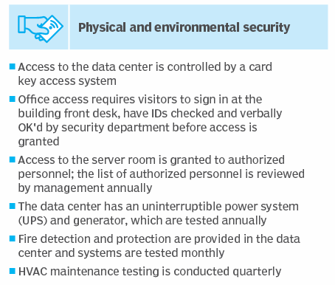
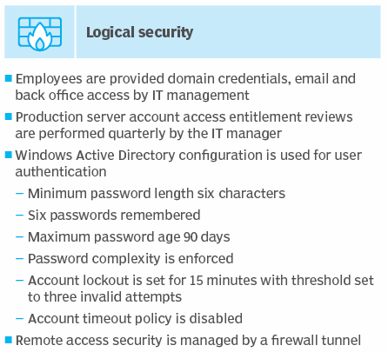

Slide 112
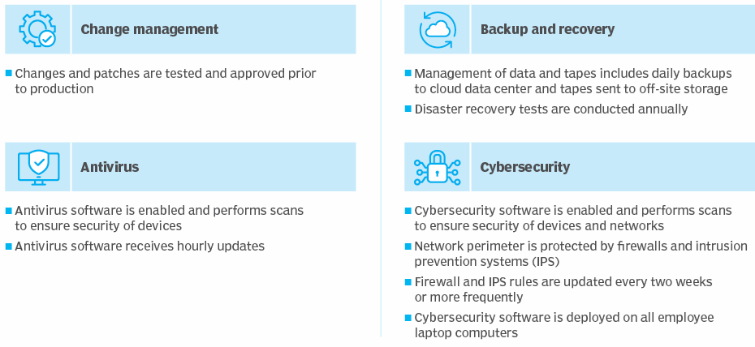

Slide 113
IT Controls Management
Provides a systematic approach to IT governance and compliance management. Then your IT organization can create or adopt IT governance frameworks to structure, manage, and maintain the processes and activities required for meeting any governance and compliance objective.
Permits you to leverage preconfigured industry-standard governance frameworks, such as CobiT and ITIL, in conjunction with in-house standards and best practices to create the governance framework that best meets the needs of your IT organization.

Slide 114
Provides functionality that maps directly to every aspect of the compliance lifecycle, while establishing a roadmap for long-term IT effectiveness. The following chart illustrates the suggested management structure for approaching governance and compliance challenges.

Slide 115
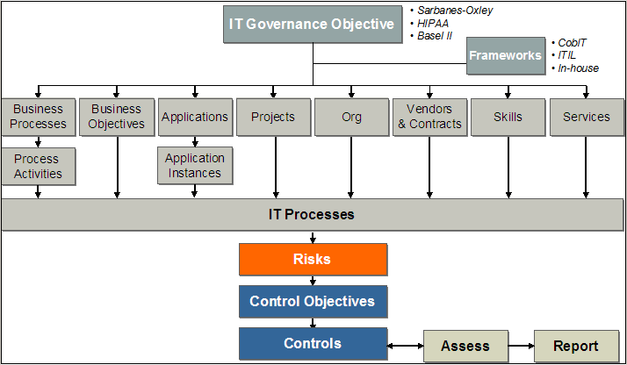

Slide 116
Monitoring and assurance practices
Monitoring Controls
Your job as a CISA is to evaluate an organization’s internal controls. Internal controls are required during the normal processing at every computer terminal or computer workstations.
Without proper controls, a minor error could become a major outage.
Controls that apply to IT service delivery:
System access controls
Data file controls
Application processing controls
Maintenance controls

Slide 117
System Access Controls
Access to computing resources needs to be controlled. It is imperative that the concept of least privilege be implemented with regard to user access of IT computing resources.
No individual should be able to log in to the system by using a level of authority higher than their job requires.
There are three types of login accounts you need to consider: user login, privileged administrator login, and maintenance login.

Slide 118
User Login and Account Management
New user login IDs are created after Human Resources notifies the IT department of an employee being hired. A similar process should exist when a contractor begins work. Some type of authorization mechanism must exist to control the creation of new accounts. Each system user is required to have a unique login ID and password.
The user login accounts should be given the minimum access rights necessary to perform their job (least priv ilege). Biometrics or electronic tokens may be implemented on systems with higher levels of security.

Slide 119
Privileged Login Accounts
Logical access to system administration functions needs to be protected by a separation of duties. Privileged login accounts should not be used for any function other than administration and maintenance. System administrators should possess two separate login accounts. The first login account should be used exclusively for system administration duties. The second login account should have no privileges other than the basic rights of the common user.

Slide 120
The system administrator should perform office administration functions while logged in as a regular user. This reduces the potential impact of errors. In addition, it improves security by reducing the time duration of privileged access. If the administrator walks down the hall to the restroom, the risk of another individual gaining physical access to the computer has been reduced. The logical separation of duties can be verified by reading system logs.

Slide 121
Maintenance Login Accounts
All computer systems have default user accounts for system setup and maintenance. The login IDs of these maintenance accounts are often well known and commercially published. Hackers love to use maintenance accounts that have been left open by careless administrators. Default login accounts should be disabled in a production system. Any valid maintenance accounts should utilize nontypical login names with strong passwords or station restrictions. A station restriction allows login to occur only from a particular system, based on the machine’s serial number or address.

Slide 122
Data File Controls
Access to data files should be controlled to ensure that unauthorized access is effectively impossible. Data access can occur through a perimeter control, direct file access, and middle ware. Middleware is software that handles data traveling from the user interface to its desti nation in the database. Each of these types of access requires special controls. It is naïve to think that a perimeter control will be completely effective. Four basic types of data protection controls are required:
Standing data controls
System control parameters
Logical access controls
Transaction processing controls

Slide 123
Standing data controls
Standing data refers to information contained in a file or database table. The information should possess controls commensurate with the data value or regulatory requirement. Standing data can be found on disk drives and tape backups.
System control parameters
Data files should be protected from system control parameters that would change the way the files are processed. System control parameters are used to customize the configuration settings and software applications. These settings can alter performance, logging, or file security.

Slide 124
Logical access controls
All access to data files should be forced through authentication in a user rights management program (access control program). Direct access to data files through Open Database Connectivity (ODBC) should be prohibited unless controlled by a rights management program with user authentication.
Transaction processing controls
All transactions involving data files should be controlled with authentication and validation checks. The data transformation procedure must be officially approved and managed as part of the system application life cycle.

Slide 125
Application Processing Controls
System security and integrity is assured through the use of application processing controls. Logical access controls require the user to log in with a unique ID and password. The user can begin processing after a successful login.
Each application should provide at least three internal processing controls:
Input
Authorization
Output.

Slide 126
Input Controls
An input control ensures that only valid and authorized information is entered into a transaction. Input controls operate by using a combination of user authorization rights, edit checking, and data entry validation.
Processing Controls
The purpose of processing controls is to ensure that the data and transactions are valid. Pro duction software programs reside in the production program library. Access to the production program library should be restricted to read-only. There is no reason for the computer programmer or the user to have write access into a production program library.

Slide 127
Output Controls
Data generated by the system should be protected to ensure confidentiality until it is delivered to the designated user. Output controls are just as important for paychecks as confidentiality is for business plans or HR records. Let’s review a few basic output controls:
Report generation and distribution - Confidential reports should be output on a printer with restricted access. The report title should indicate that the report is confidential.
Negotiable instruments - Checks, bonds, and stock certificates are frequently printed on computers. These items should be protected by a combination of logical and physical controls.
Report retention - Certain types of reports may be required to be controlled under a document retention policy.
Event logs - Processing logs and audit trails should be protected for integrity and confidenti ality at all times.

Slide 128
Maintenance Controls
Maintenance controls exist to ensure that hardware and software changes will have a minimum impact on processing schedules and system availability. All maintenance should be approved by the change control process before it occurs. It is not uncommon for an organization to issue blanket approval for small changes with low risk. Let’s look at some of the issues that should be addressed prior to performing maintenance.
Backup and Recovery - System programs and data should be backed up before maintenance occurs. The backup tapes (or media) should be read/write verified.
Project Management - Project management with a risk analysis should be performed prior to starting maintenance. Most maintenance is a mini project. As the scope of the maintenance increases, so should the project planning.

Slide 129
IT ASSUARANCE PRACTICES
Service assurance is the practice of delivering IT services — comprising disciplines such as business application delivery, security services, customer support, disaster recovery services, and governance and compliance services — at a measurable, high-quality level.
IT directors today are not just asked to improve service levels, they are tasked to guarantee superior service.
The result is the growth of IT service assurance, which gives IT management the tools it needs to ensure that services are meeting the expectations of the business (as formal service level agreements, known as SLAs) — and ultimately, the ability to run IT operations as a full-fledged business unit. IT service assurance provides IT management the detailed visibility it needs into its operations, making it possible to tie IT operations to business outcomes and related financial budgets.

Slide 130
Common IT Service Assurance Tools
IT service assurance tools include the following:
Service desk/ticketing systems: Addressing common key performance indicators (KPI), the service desk provides incident management and problem management support — getting to the root cause of issues and resolving them through a regimented ticketing system.
Configuration management systems: These tools rely on automation for the provisioning of software to end-user equipment, tracking and controlling changes, ensuring patches are delivered promptly and accurately.
Asset management systems: These systems track all devices on the network (including hardware and software) to ensure they are accounted for and operating correctly.

Slide 131
Contract and license management systems: Complex software licensing needs to be carefully tracked to ensure legal compliance.
Change management systems: These systems ensure that rollouts of new software and policies are timely and standardized, with the aim of ensuring consistency and reducing incompatibilities or other errors introduced in the process.
Service catalog management systems: The service catalog is the list of software and services available to end users, allowing IT to manage those systems when users request access to a listed product.

Slide 132
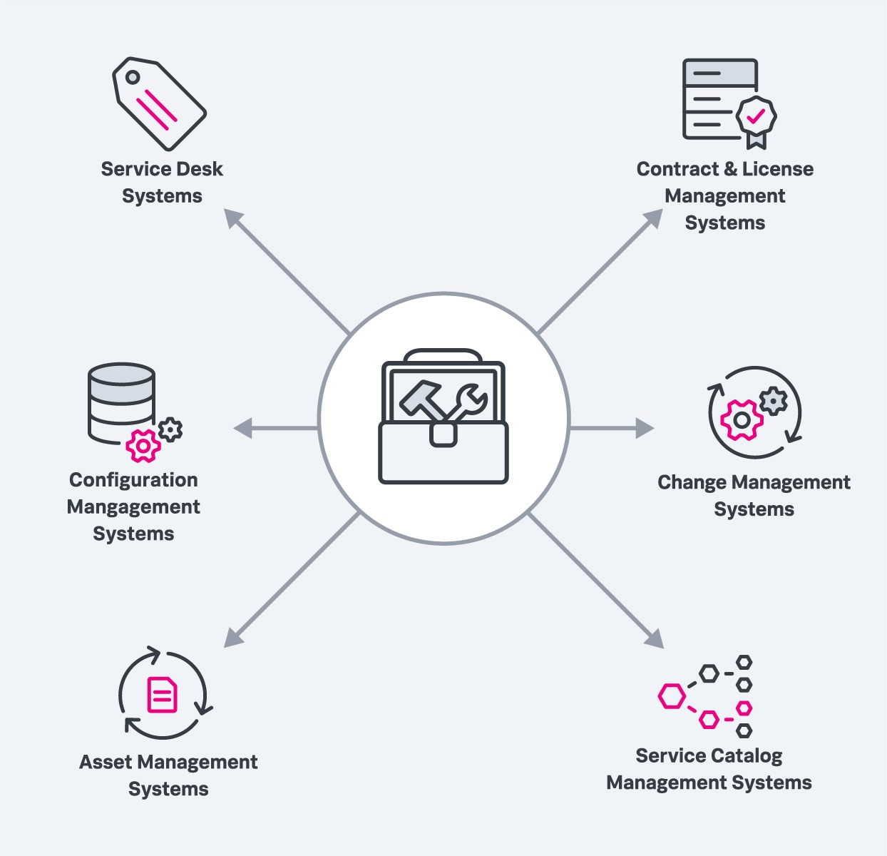

Slide 133
Service Assurance Functions
The day-to-day operations of IT service assurance includes:
Managing the service desk
Maintaining service performance via performance monitoring
Improving workflows
Tracking IT assets
Keeping the service catalog updated
Updating network service assurance functions to prevent network degradations
The overarching function is to align IT with the business as a whole. This includes delivering strong performance to internal and external customers and engaging in a continuous improvement process to correct poorly performing systems and meet the changing needs of the business, ultimately improving profitability.

Slide 134
IT service assurance also includes managing relationships with IT service providers, developing and managing detailed SLAs, communicating progress and status of SLAs to management, and working with the business to develop new service offerings.
The role of IT service assurance is IT performance optimization in all of these areas, including customer satisfaction and the end-user experience.

Slide 135
IT Service Assurance Plans
An IT service assurance plan, as the name suggests, is designed to monitor IT services over time. This plan may be developed internally by the IT organization or be part of a contract with an external service assurance provider.
Components of an IT service assurance plan may include:
Network operations: All devices on the network (and in the cloud) should be kept in working order via network monitoring, with SLAs specifying a minimum level of uptime as well as meeting various KPIs, such as available bandwidth, server response time and other network performance metrics
24/7 service desk operations: These operations specify various metrics and key SLAs, including a maximum response time to each call and a maximum resolution time once a request is answered.

Slide 136
Automated configuration and change management: Systems use automation to rollout patches, updates and new software to client machines. SLAs may specify the maximum time before patches are delivered and a maximum percentage of unpatched devices on the network.
Automated asset tracking: Automated systems continually update databases and other data center assets as devices are deployed, serviced, upgraded and eventually retired.
Service catalog management: The organization’s service catalog should be kept up-to-date and available, with the latest versions of tested and certified software tools before they’re rolled out to users.

Slide 137
IT resource management
What is IT Resource Management?
IT resource management involves managing an organization’s IT resources, which include hardware, software, applications, and networks.
IT resource management is a critical component of IT service management (ITSM) and involves several processes, such as service asset and configuration management, capacity management, and availability management.

Slide 138
The primary objective of IT resource management is to optimize the use of IT resources and ensure that they are aligned with the organization’s goals and objectives.
This involves identifying and prioritizing IT projects, allocating resources, and monitoring and controlling costs.
Why is IT Resource Management Important?
Effective IT resource management is critical to the success of an organization’s IT operations.
It can help companies reduce costs, increase efficiency, and improve the quality of their IT services.
Additionally, it can help organizations identify areas where they can improve their IT infrastructure and make more informed decisions about IT investments.

Slide 139
Effective IT resource management also enables organizations to:
Align IT with Business objectives: IT resource management helps ensure that IT resources are aligned with the organization’s goals and objectives, ensuring that the IT function is delivering value to the business.
Optimize resource utilization: IT resource management helps organizations optimize their use of IT resources, reducing waste and maximizing efficiency.
Manage costs: Effective IT resource management can help organizations control IT costs, ensuring that IT investments are made wisely and delivering the maximum return on investment.

Slide 140
Key Elements of Effective IT Resource Management
Effective IT resource management involves several key elements, including:
Resource planning: IT resource management requires a detailed understanding of the organization’s IT infrastructure and the resources required to support its operations.
Resource planning involves identifying and prioritizing IT projects, allocating resources, and monitoring resource usage to ensure that resources are being used effectively.
Performance monitoring: Effective IT resource management requires continuous monitoring of IT resources to ensure that they are performing optimally.
This involves monitoring performance metrics such as uptime, response time, and availability to identify areas where improvements can be made.
Capacity planning: Capacity planning is the process of forecasting future IT resource requirements based on the organization’s growth and changes in IT demand.

Slide 141
IT contracting strategies and policies
IT contracting strategies refer to the approaches and practices organizations use when engaging with external vendors or contractors for IT-related services. These strategies aim to optimize the procurement process, manage risks, and ensure successful project outcomes.
Here are some common strategies:
Outsourcing:
Organizations hire external vendors to perform specific IT tasks or projects.
Benefits include cost savings, access to specialized skills, and scalability.
Risks include loss of control and potential quality issues.

Slide 142
2. Offshoring:
Organizations contract with vendors in different countries to leverage cost advantages.
Considerations include time zone differences, cultural nuances, and communication challenges.
3. Insourcing:
Organizations build in-house capabilities rather than relying on external vendors.
Advantages include better control, security, and alignment with organizational goals.
Challenges include resource allocation and skill development.

Slide 143
4. Strategic Partnerships:
Long-term relationships with key vendors.
Collaborate closely, share risks, and align goals.
Requires trust and effective communication
5. Multi-Sourcing:
Diversify vendors to avoid dependence on a single provider.
Balance cost, quality, and flexibility.
Requires strong vendor management.
6. Fixed-Price Contracts:
Set price for a defined scope of work.
Suitable for well-defined projects.
Risk lies with the vendor if scope changes

Slide 144
7. Time and Materials Contracts:
Pay based on actual effort and materials used.
Flexible for evolving projects.
Risk lies with the organization if scope changes.
8. Service-Level Agreements (SLAs):
Define performance expectations (e.g., response time, uptime).
Ensure alignment with business needs

Slide 145
Certainly! IT contracting policies are essential guidelines and rules that organizations establish to govern their interactions with external vendors or contractors. These policies help ensure effective procurement, risk management, and successful project outcomes. Here are some critical IT contracting policies:
Acceptable Use Policy:
Defines acceptable use of company assets, data, and behavior for all users.
Provides a baseline for employee actions related to computing assets.
Data Classification Policy:
Crucial for information security.
Ensures consistent data classification (e.g., sensitive, confidential, public).
Guides risk decisions and governance

Slide 146
3. Remote Access Policy:
Vital as organizations shift to hybrid work environments.
Defines rules for secure remote access to company systems.
4. Software and IT Contract Negotiation Rules:
Avoid paying for maintenance or support prematurely.
Be cautious with non-disclosure agreements (NDAs) related to data security.
Evaluate SaaS escrows carefully.
Protect intellectual property (IP) indemnity.

Slide 147
Risk management practices
Risk management is the process of identifying, monitoring, and managing risks and their harm to a business. These risks can range from data loss, cyberattacks, and security breaches, to system failures and even natural disasters.
5 Best Practices for Risk Management
Risk management is an ongoing process and doesn’t end once your risks have been identified and remediated. Therefore, your organization’s risk management practices should be revisited every year to ensure policies, procedures, and risks are up-to-date and relevant.

Slide 148
Here are five best practices to keep in mind as you create and deploy your organization’s risk management plan:
Implement Risk Accountability for every employee. Creating enterprise-wide accountability will help incorporate risk-based thinking into your day-to-day activities while promoting a beneficial, risk-aware culture.
Get a champion Risk from the Top on board for your risk management plan to be truly effective.

Slide 149
Conduct Regular Risk Assessments to keep your risk profile (or cyber risk profile) up to date and ensure your business leaders have the most current information before decision-making process that could impact your organization’s risk profile.
Quantify & Prioritize Risks, including their probability and impact, as well as mitigation costs, so you know best where to maximize the return on investing in risk treatments, including your compliance program.
Implement Risk Treatments, including strong controls, metrics, and management tools to help with ongoing risk management and actively reduce your top priority risks.

Slide 150
Business continuity planning (BCP)
What is a business continuity plan (BCP)?
A business continuity plan (BCP) is a document that consists of the critical information an organization needs to continue operating during an unplanned event.
The BCP states the essential functions of the business, identifies which systems and processes must be sustained, and details how to maintain them. It should consider any possible business disruption.

Slide 151
A BCP covers risks including cyber attacks, pandemics, natural disasters and human error. The array of possible risks makes it vital for an organization to have a business continuity plan to preserve its health and reputation. A proper BCP decreases the chance of a costly power outage or IT outage.
IT administrators often create the plan. However, the executive staff participate in the process, providing knowledge of the company and oversight. They also ensure the BCP is regularly updated.

Slide 152
Importance of business continuity planning
Business continuity planning is a proactive business process that lets a company understand potential threats, vulnerabilities and weaknesses to its organization in times of crisis. The creation of a business continuity program ensures company leaders can react quickly and efficiently to business interruption.
A BCP enables a company to continue to serve customers during a crisis and minimize the likelihood of customers going to competitors. These plans decrease business downtime and outline the steps to be taken -- before, during and after an emergency -- to maintain the company's financial viability.

Slide 153
Elements of a business continuity plan
According to business continuity consultant Paul Kirvan, a BCP should contain the following items:
initial data at the beginning of the plan, including important contact information;
a revision management process that describes change management procedures;
the purpose and scope;
how to use the plan, including guidelines as to when the plan will be initiated;
policy information;
emergency response and management procedures;

Slide 154
step-by-step procedures;
checklists and flow diagrams;
a glossary of terms used in the plan; and
a schedule for reviewing, testing and updating the plan.
Business continuity planning steps
The business continuity planning lifecycle contains these five steps:
Information gathering and analysis, featuring business impact analysis (BIA) and risk assessment (RA);
plan development and design;
implementation;
testing; and
maintenance and updating.

Slide 155
BCP implementation
Once the business has started the planning process, it launches the BIA and RA processes to collect important data. The BIA defines the critical functions that must continue during a crisis and the resources needed to maintain those operations. The RA details the potential internal and external risks and threats, the likelihood of them happening, and the possible damage they could cause.
The next step determines the best ways to deal with the risks and threats outlined in the BIA and RA, and how to limit damage from an event. A successful business continuity plan defines step-by-step procedures for response.

Slide 156
The BCP should not be overly complex and does not need to be hundreds of pages long; it should contain just the right amount of information to keep the business running. Small businesses can use a one-page plan with all the necessary details. That can be more helpful than a long plan that is difficult to use. Those details should include the following:
minimum resources needed for business continuity;
locations where that can take place;
personnel needed to accomplish it; and
potential costs.

Slide 157
BCP testing
An organization's technology, processes, staff and facilities constantly change. Therefore, regular testing, reviewing and updating of a BCP is critical. Plan testing should be undertaken using tabletop exercises, walk-throughs, practice crisis management communications and emergency enactments to test the viability of the plan and to see how employees and executives react under stress.
Regular testing and maintenance ensure the BCP is current and accurate. A simple test of a business continuity plan might involve talking through it. A complex test requires a full run-through of what will happen in the event of a business disruption.

Slide 158
The test can be planned in advance or it can be done spur of the moment to better simulate an unplanned event. If issues arise during testing, the plan should be corrected accordingly during the maintenance phase. Maintenance also includes a review of the critical functions outlined in the BIA and the risks described in the RA, as well as plan updating if necessary.
A business continuity plan must be continually improved; updates should not wait for a crisis. Staff members involved in the plan must get regular updates and business continuity training. An internal or external business continuity plan audit should be used to evaluate the effectiveness of the BCP and highlight areas for improvement.

